Slide 1
Chapter 3
Networks and The Internet

Slide 2
Topics
Introduction
The Ever-Expanding Network
The World Wide Web
Browsers and Servers
404 Status Code
How Do Browsers Work
Networks
OSI Network Model
TCP/IP Model
Network Protocols

Slide 3
Chapter Objectives
By Completing this chapter, you should be able to:
Understand How is data sent from one computer to another.
Explain the relationship between a browser and a server.
Understand code turned into the experience that users see in their browsers.
Identify types of networks.
Understand conceptual models to describe all the layers of networking
Understand important network protocols.

Slide 4
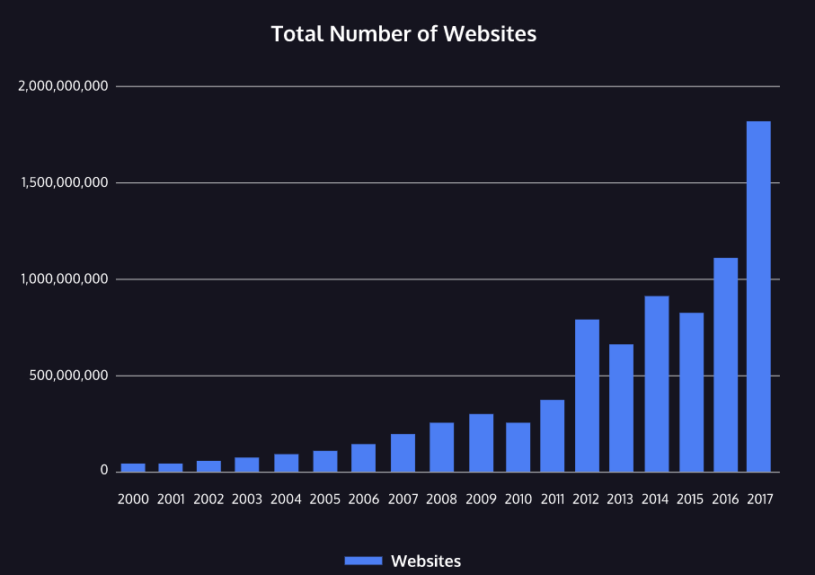
Introduction
It is nearly impossible to overstate how much the internet has changed how we consume information and communicate with one another.
More than four billion people around the world are internet users and the total number of websites on the world wide web is nearing two billion.

Slide 5
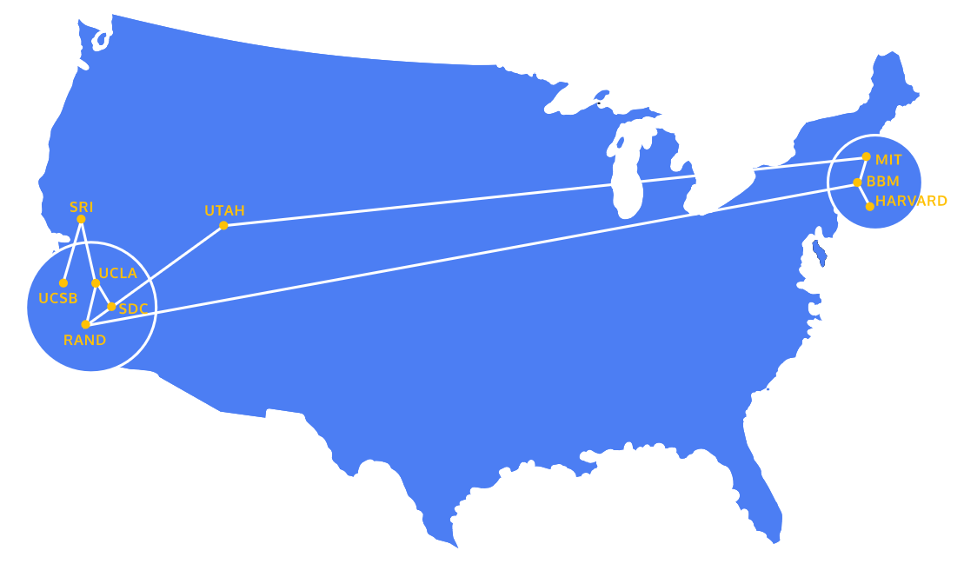
The Ever-Expanding Network
So how did the internet start?
In 1969, the United States Department of Defense funded the creation of ARPANET, a precursor network to the internet.
ARPANET stands for Advanced Research Projects Agency Network.
ARPANET connected supercomputing centers run by government agencies and universities.

Slide 6
The Ever-Expanding Network
The institutions wanted to connect their individual networks for large-scale information transfer.
However, many of them followed different standards and technical implementations.
In the 1970s, the transmission control protocol and internet protocol (TCP/IP), were created to provide standards around the transfer of data that would allow these early networks to communicate with each other.
TCP/IP was researched and specified throughout the 1970s and adopted in the early 1980s. As different networks adopted TCP/IP, the interconnected global network of networks that is today known as the internet was formed.

Slide 7
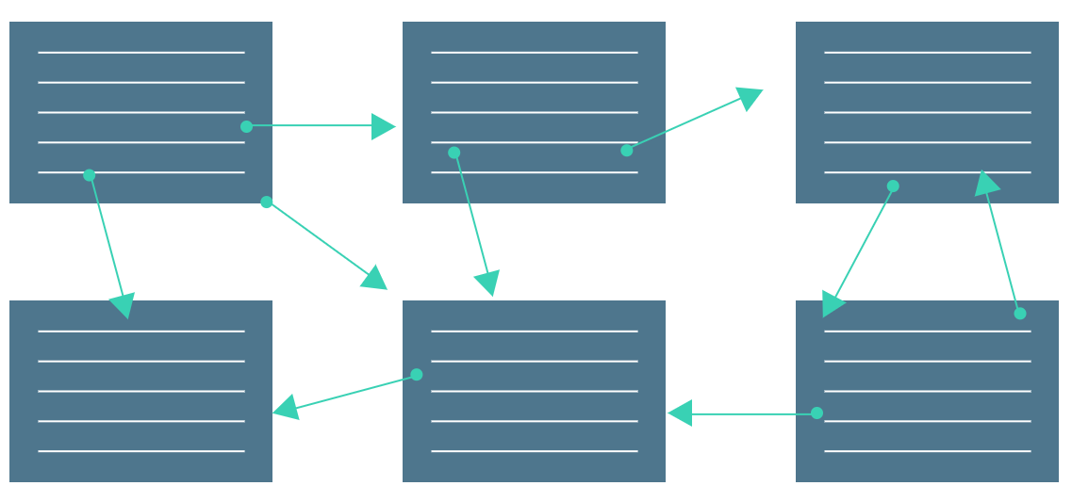
The World Wide Web
While people today often use the terms internet and world wide web interchangeably, they actually refer to quite different things.
The internet refers to the actual network of connected computing devices.
Although the internet was around in the 1980s, there was not an intuitive way for most people to browse the internet.
The internet just sent messages produced by one computer and presented them to another computer.

Slide 8
The World Wide Web
Engagement with the internet changed in 1989 when Tim Berners-Lee invented the world wide web.
The world wide web is a collection of interlinked websites and other web resources.
The world wide web, in combination with the rise of web browsers in the 1990s, introduced a user-friendly interface that enabled users to browse multimedia content and interact with other users.
The invention of the world wide web led to the use of the internet in wider society through the 1990s and the creation of a variety of websites that are still in use today.

Slide 9
Browsers and Servers
As we’ve seen, the internet is a network that links computer devices worldwide, enabling people to share information with one another despite vast distances. But how is information sent from one device to another?
One way of understanding this process is to look at the client-server model.
In this model, the client refers to the user’s device or program that is making a request for data.
A client can be a browser or application running on a user’s computer, smartphone, or tablet.

Slide 10
Browsers and Servers
The server is the device or program in that network that waits for incoming requests and sends back data. This might be an
in-house server,
a rented server at a data center,
cloud server.
The browser and server communicate with one another using the internet protocol known as Hypertext Transfer Protocol (HTTP) which allows for data transfer.

Slide 11
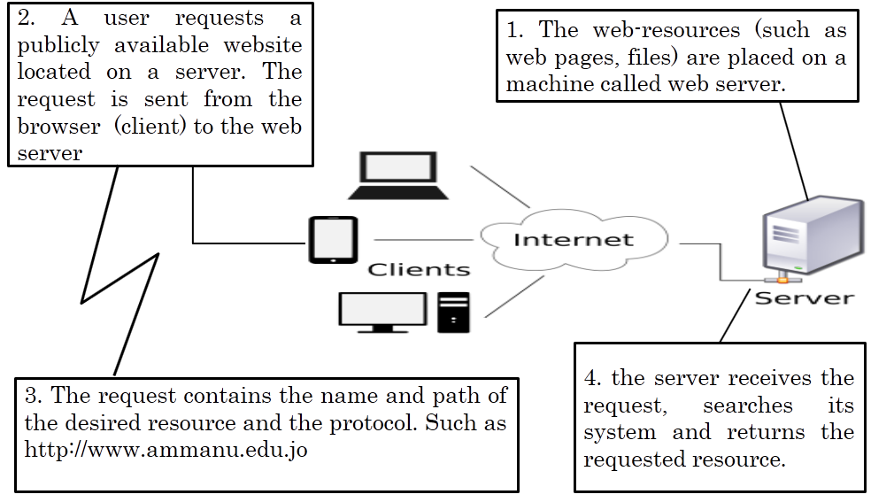
Browsers and Servers
What happens when you request a website in your browser?

Slide 12
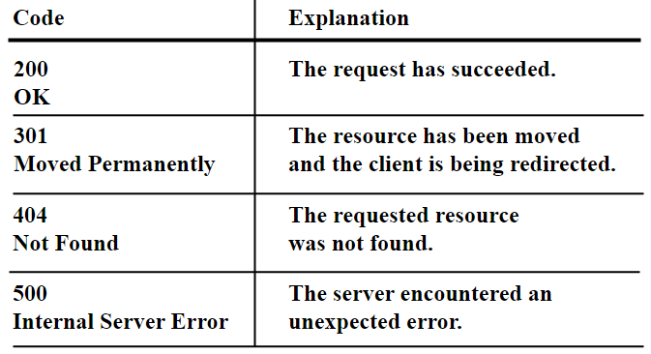

404 Status Code
When a server responds to a client, the server specifies a status code as a part of the response.
Status codes indicate whether or not the HTTP request was successfully completed and if there was an error, they contain some information about the type of error that happened.
The status code helps the browser know how to handle the data that was sent back with the response.
press on chrome icon

Slide 13
How Do Browsers Work?
So far we’ve seen how a single request and response are handled between a client and a server.
But most of the time, our devices aren’t making a single request. Every time we load a webpage, our device sends a request for each file that makes up that page.
So even when we’re just loading one webpage, that page can make multiple requests in order to retrieve different pieces of content, like images.

Slide 14
How Do Browsers Work?
How does this process work when we’re making multiple requests simultaneously? All of the following steps happen in a split second:
When a user types in a URL and presses enter, the server processes the request and sends the HTML file back to the client.
HTML files hold the content of a website and they also contain links for any additional assets or code that are needed to display the site properly.
The browser will begin to search for elements in the HTML file and it will start to make additional HTTP requests for any other external resources used by the HTML file.

Slide 15
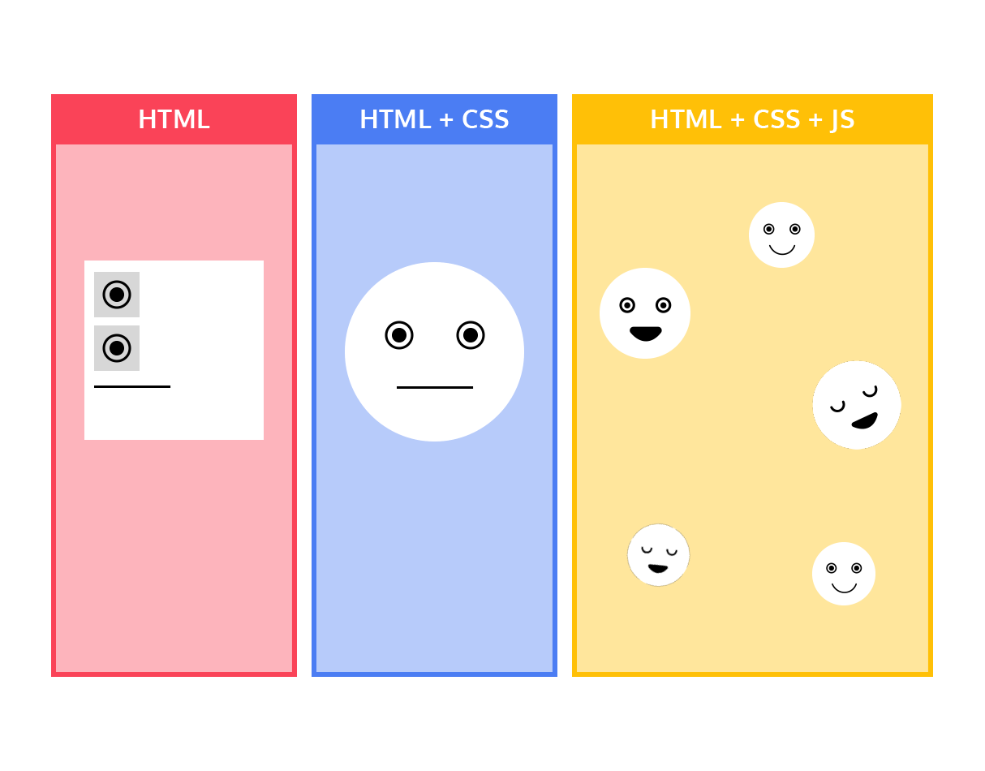
How Do Browsers Work?
This often includes:
One or more CSS stylesheets. CSS stands for cascading style sheets; CSS creates the style and layout of a web page.
The request-response cycle also sends website assets, like images and videos, from the server to the browser. If these files are large, there might even be a noticeable delay before they are rendered by the browser.
One or more JavaScript files. JavaScript makes the webpage interactive.

Slide 16
How Do Browsers Work?
In most modern browsers, these additional requests are made in parallel. The browser does not wait to receive one resource before requesting the next resource.
This whole process typically happens in about a second or less, depending on :
the speed of the user’s connection,
the size of the website
the physical distance between the browser and the server.

Slide 17
Networks
A network is two or more computers or devices that are linked in order to share information.
Our computers and devices are able to communicate due to a large set of standards, much like we have road systems and traffic protocols when we drive a car.
These network standards have been built by the community over the decades, and these standards guide engineers and security professionals.

Slide 18
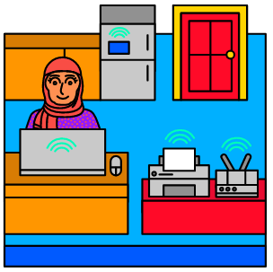
Types of Networks
Networks are broken into different subsets based on their size and function. Here are some of the most common network types:
LAN: A Local Area Network (LAN) is a smaller network that connects multiple devices in a limited area. Examples of LANs include small offices, a home, or any other network contained within a small area.

Slide 19
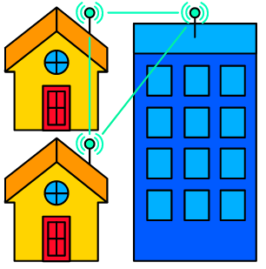
Types of Networks
CAN: A Campus Area Network (CAN) connects multiple computers and devices over a slightly larger area. In many cases, these types of networks will connect multiple buildings located in the same neighborhood.

Slide 20
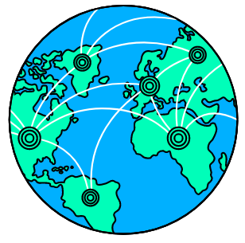
Types of Networks
WAN: A Wide Area Network (WAN) connects multiple computers over a geographically large area. Large, international organizations may operate these types of networks.
Since we’re all connected to the Internet, the whole Internet can technically be classified as a WAN!

Slide 21
OSI: Network Model
The OSI (Open Systems Interconnection) Model was developed in the 1970s and 1980s, and it is a conceptual model that breaks networking into seven separate layers.
Each layer refers to a set of functions that are responsible for specific tasks.
The layers start from physical signals all the way up to the web applications we interact with.
Each layer generally only interacts with the layer below it and provides useful tools or information to the layer above it.
OSI is used to help us categorize network processes so we can communicate about them during troubleshooting and while improving security.

Slide 22
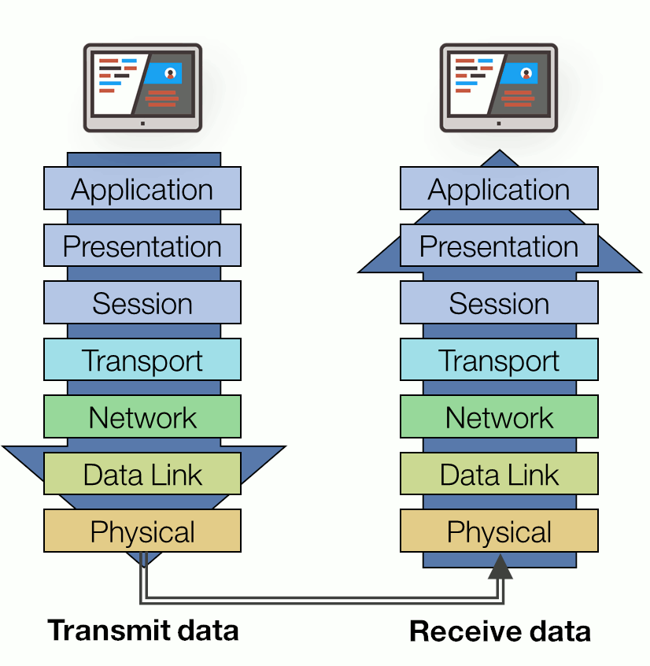
OSI: Network Model

Slide 23
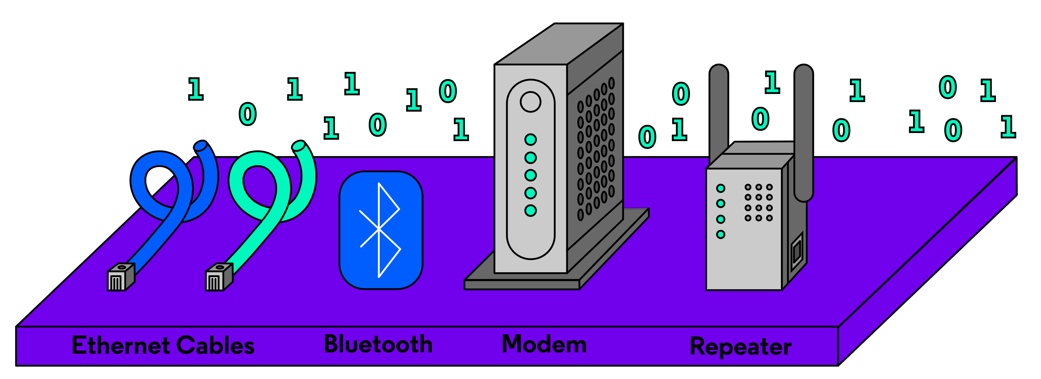
OSI: Layer 1 – Physical
The Physical, and lowest layer of the model, covers how unstructured data, like bits, is transmitted.
Technology such as WiFi, Bluetooth, and cable standards such as CAT5 and CAT6 all operate at this layer. This layer also includes the hardware part of modems, adapters, and repeaters.
The raw data bits are received as a stream of 0’s and 1’s.
Fixing errors that occur just at this layer means considering physical damage or interference.

Slide 24
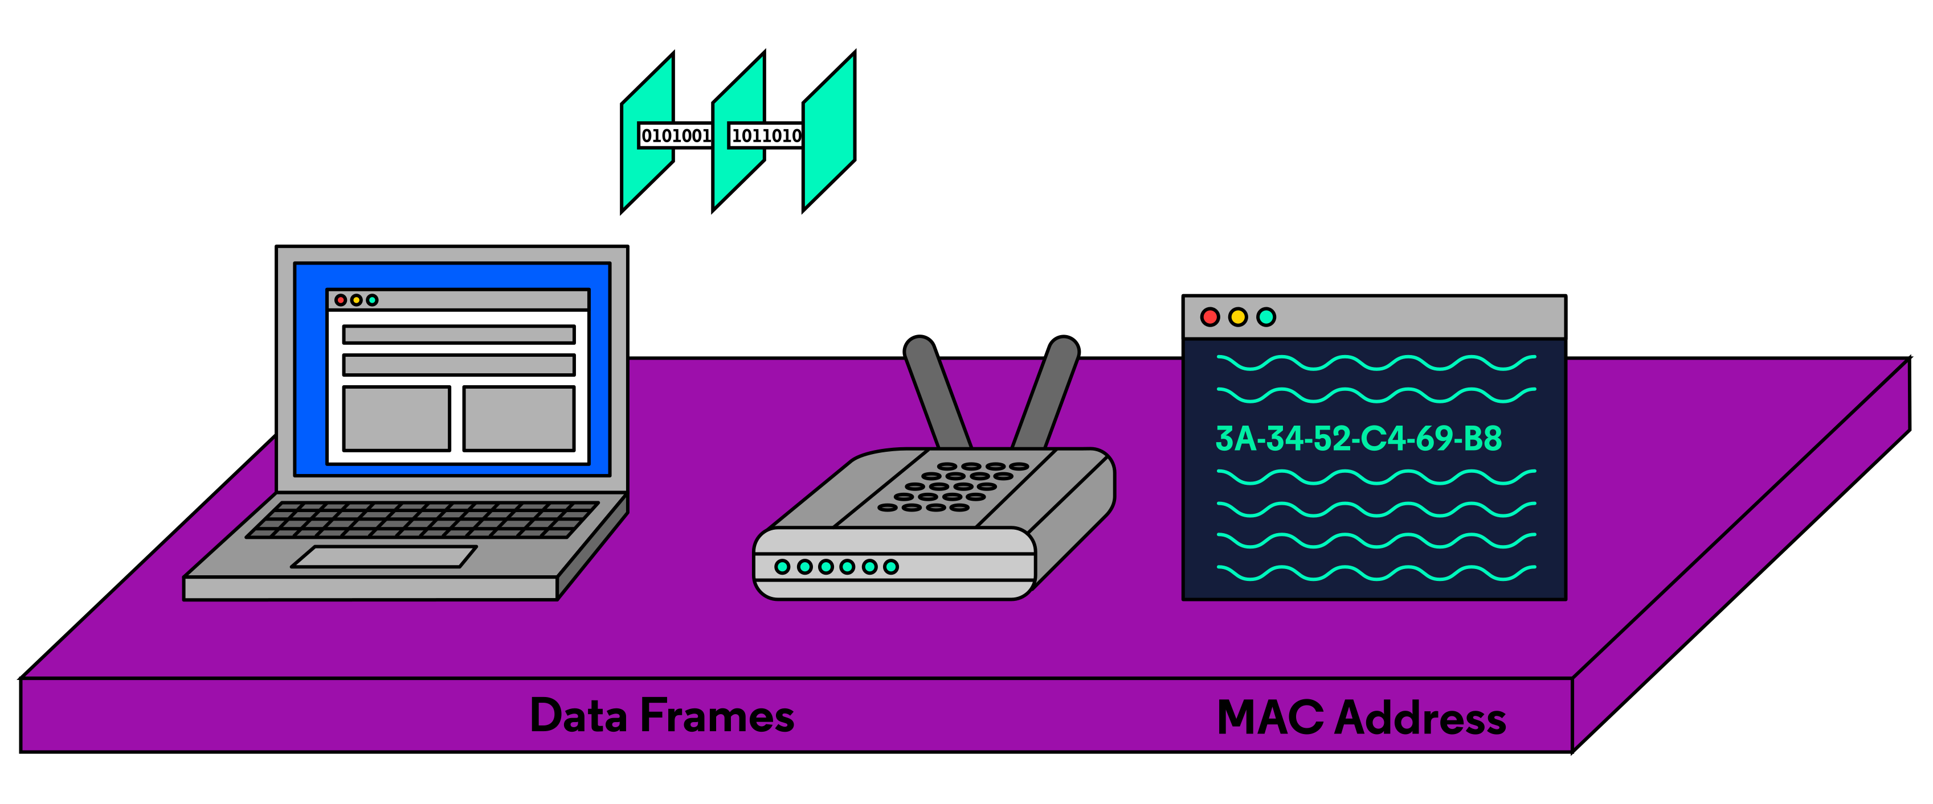
OSI: Layer 2 – Data Link
The Data Link layer covers how data is sent from device to device when they are connected on the same local network. The data link layer includes many functionalities:
It structures incoming or outgoing data bits into data frames.
It involves physical addresses of devices, called Media Access Control (MAC) address.
It routes data frames to the correct physical addresses.
It ensures the flow of data is synchronized between devices.
It detects errors within data frames. This involves a system of error control.

Slide 25
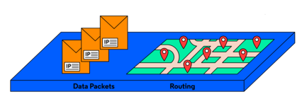
OSI: Layer 3 – Network
The Network layer describes how data packets are routed between wider networks such as the Internet. Whereas a data frame at the data link layer travels to local MAC addresses, a data packet at the network layer is routed from a source IP (Internet Protocol) address to a destination IP address.
Think of a data packet as an envelope. IP addresses are assigned to every computer or device connected to the Internet, and these addresses are formatted into four numbers each ranging from 0 to 255.

Slide 26
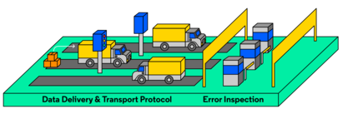
OSI: Layer 4 – Transport
The Transport layer refers to how data is actually transferred. Let’s say you wanted to upload a photo from your phone onto social media. The transport layer handles how the image data from that photo is split (segmentation), the rate at which the packets are sent, and how errors are handled if data packets don’t make it to the site’s server.
The most common transport protocols on the Internet are TCP (Transmission Control Protocol) and UDP (User Datagram Protocol). حزمة معلومات المستخدم

Slide 27
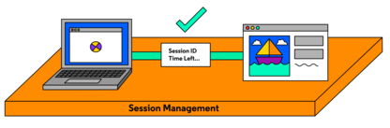
OSI: Layer 5 – Session
When two computers or devices have started an exchange of information, we call that a session. The Session layer in OSI is responsible for opening, closing, and maintaining sessions.
In terms of opening and closing, the session layer includes authentication and authorization measures. For example, without logging in or having the right permissions, you may not be able to connect to parts of a website.
But if you are logged in, your access permission is stored for a set amount of time, or session length.صلاحيات الدخول والمصادقة

Slide 28
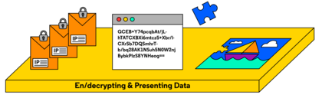
OSI: Layer 6 – Presentation
The Presentation layer includes all the methods that convert data into a format usable by an application.
This layer handles functions:
encoding/decoding,
encryption/decryption,
compression/decompression of files.

Slide 29
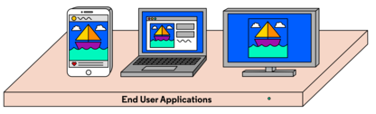
OSI: Layer 7 – Application
The final layer of the OSI model is the Application layer.
This layer includes websites, browsers, email, mobile applications, and how they reduce Internet data so that we can interact with it.

Slide 30
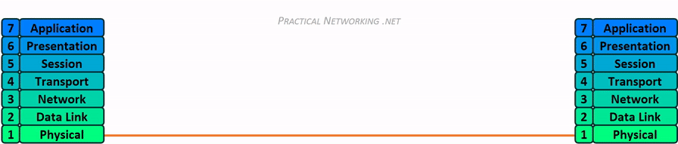
How OSI Model works

Slide 31
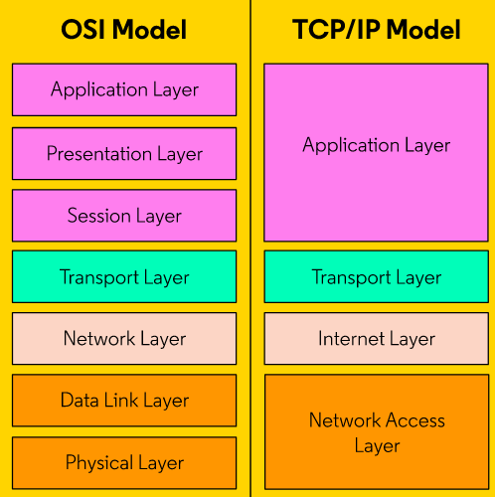
TCP/IP Model
The OSI Model isn’t the only model that describes networking.
The TCP/IP model is a 4-layered model that makes direct reference to current Internet implementations.
Application Layer:
This includes the opening and closing of sessions, translating data, and the interaction with content at the application level. Here, there are multiple protocols for web content, email, and accessing files, including HTTP, FTP, SMTP, and more.

Slide 32
TCP/IP Model
Transport Layer:
TCP and UDP are the core protocols here.
TCP is a connection-oriented protocol, where a more difficult acknowledgment between one sender and one receiver must happen before any data can be sent.
This protocol also includes flow control and error recovery, It is used when larger amounts of data need to be sent and timing is less of a concern.
UDP is a more lightweight protocol that does not require a fixed channel between a sender and receiver. It is used when the amount of data sent is piecemeal مقسمةand needs to be transmitted quickly.

Slide 33
TCP/IP Model
The Internet Layer:
This is where IP addressing and routing occur.
Network Access Layer:
Sometimes called the Link layer, this layer encompasses the sending or receiving of network data at the local network level.

Slide 34
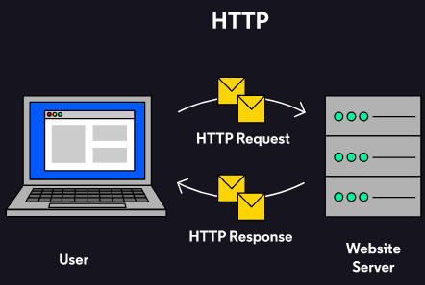
Network Protocols
They are simply a set of standards for devices interacting on the Internet!
Http:
The HTTP (The Hyper Text Transfer Protocol) handles our web requests to servers.
HTTP uses a set of verbs, like GET, POST, PUT and HEAD, to retrieve and send data.

Slide 35
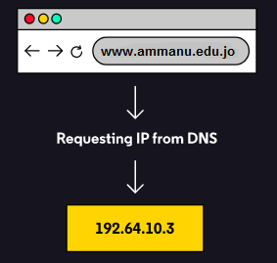
Network Protocols
DNS:
The Domain Name System (DNS) protocol converts domain names to IP addresses.
Think of it as a phonebook for the Internet. It’s hard to remember an exact IP address when we want to access a website. When we request the URL ammanu.edu.jo our computer sends a DNS request to a DNS server.
The server then returns the correct IP addresses to route data to and from ammanu.

Slide 36
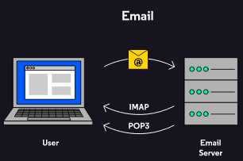
Network Protocols
IMAP, POP and SMTP:
IMAP (Internet Message Access Protocol) and POP (Post Office Protocol) allow users to access emails stored on a remote web server.
In IMAP, servers store your email and return copies to you, allowing you to access the same email on multiple devices.
In POP3 (POP version 3), however, emails are generally downloaded from the server onto just a single device.
To send email, the standard is SMTP (Simple Mail Transfer Protocol).

Slide 37
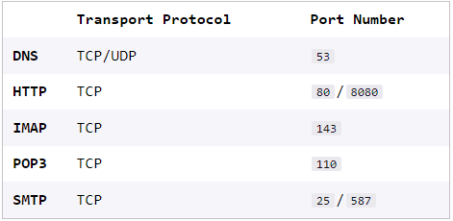
Network Protocols
How do data packets get routed to these services from the transport layer? Specific numbers called ports are reserved so that packets for different services can come in at the same time. Think of ports as lanes for network traffic! فكر في المنافذ على أنها ممرات لحركة مرور الشبكة!

Slide 38
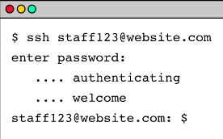
Network Protocols
SSH:
Secure Shell (SSH) is used to access a remote terminal or virtual machine (VM) over a secure connection.
IT professionals and engineers use this to help configure and program a system remotely and securely. For example, accessing GitHub from the command line uses SSH! مشاركة المشاريع

Slide 39
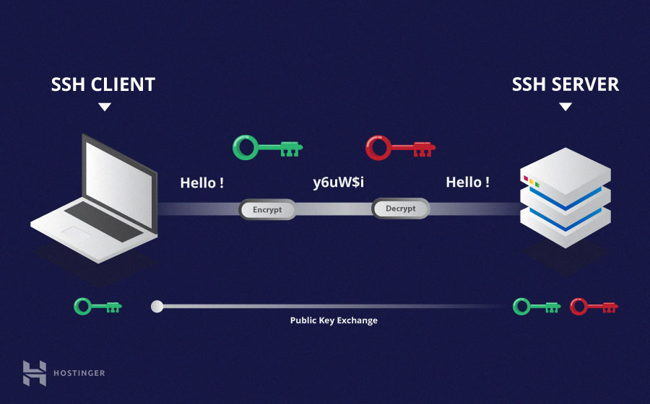
Self Reading
SSH (Secure Shell) is a cryptographic network protocol that allows secure communication between two systems over an unsecured network. GitHub uses SSH as one of its authentication methods for users to securely connect to and interact with their repositories.
Using SSH provides an added layer of security for accessing and working with your repositories on GitHub. It encrypts the communication between your local machine and GitHub's servers, preventing unauthorized access to your code and data.

Slide 40
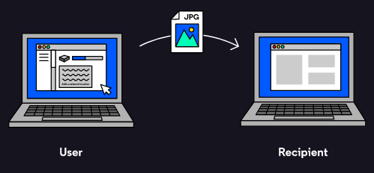
Network Protocols
FTP:
The File Transfer Protocol (FTP) is used to transfer files from one system to another. Modern implementations of FTP can include encryption as well.

Slide 41
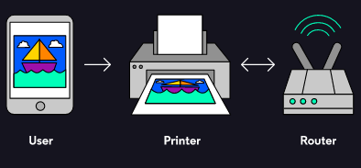
Network Protocols
SMB:
The Server Message Block (SMB) protocol allows multiple users to interact with a remote system like a file share or printing services. Multiple people can view and modify shared resources and files in a centralized server.

Slide 42
Wrapping up
We now have a general understanding of how the internet works, including:
The growth of the internet as a network.
The difference between the internet and the world wide web.
The relationship between browsers and servers.
HTTP status codes, like 404 Not Found.
We also discussed Network types, layers and protocols.

